Slide 1


GoLift
Team Squat Squad
Merrick Swaffar
Nishika Tripathi
Siobhan O’Shea
Jenna Wu
Peyton Fonck
July 27, 2016

Slide 2
Problem/Application Domain
What opportunity/problem did you address?
Thinking what makes this workout/diet app different than the ones that are already out there
Thinking of features to be implemented in the app
Difficult features that was too challenging to finish in the amount of time given
Why/for whom is it interesting/exciting?
Team:
Felt it was challenging but at the same time learned many new things
Product Owner is a health freak
Felt this can be an app that be used everyday
Customers:
Organizing their workout/diet plans

Slide 3
Goals
Set Out to Achieve: Initial Vision
Create a workout/diet app
Track and log meals and exercises
Compare the results from different days
Meal and workout suggestions based on personal needs
Create a login page
Achieved: Final Result
Creating a workout/diet app
Added a quiz to determine body type rather than personal needs
No login page and comparing the results from different days

Slide 4
Challenges and Accomplishments
Software Product
Challenges:
Learning Android technologies
Accomplishments:
Implementing most of the features that were planned
Software Development Process
Challenges
Incorporating good engineering practices with scrum
Following the scrum process
Accomplishments:
Smooth team workflow

Slide 5
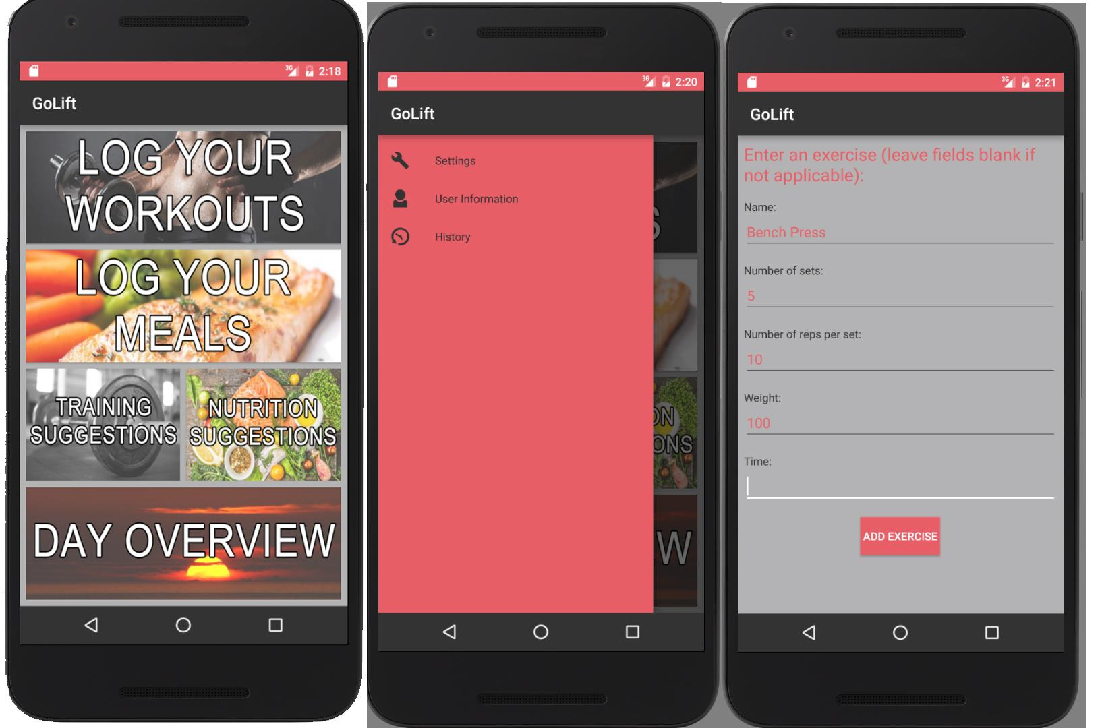
GoLift

Slide 6
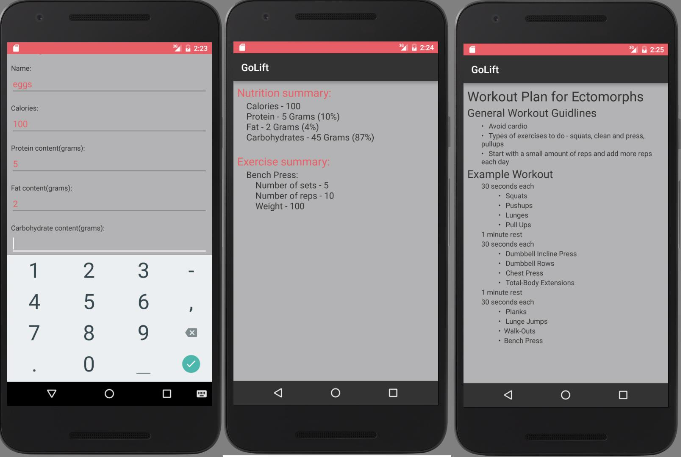
GoLift

Slide 7
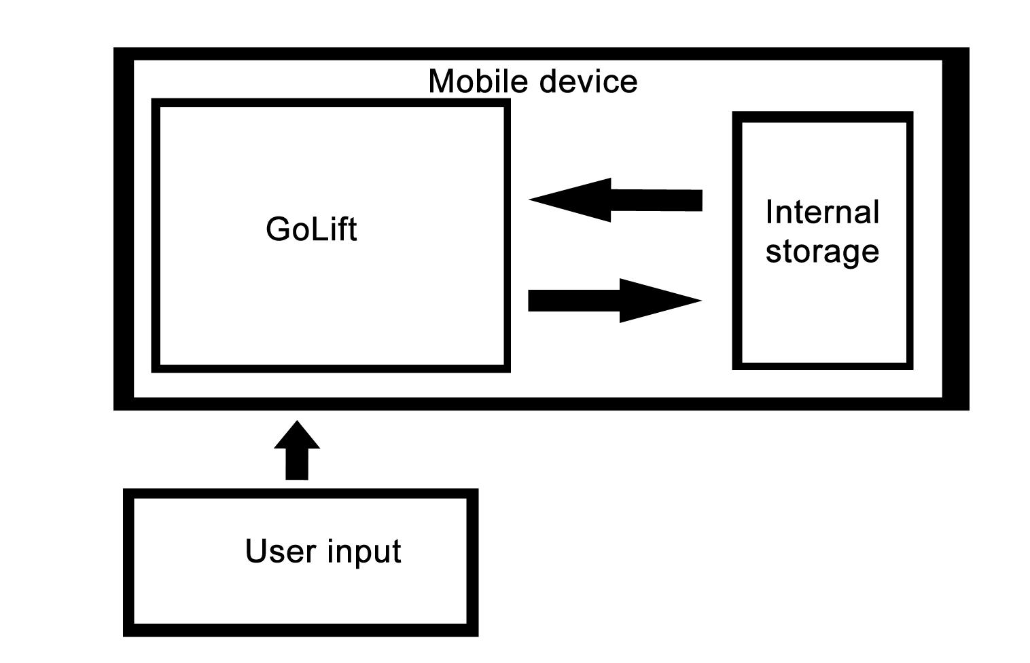
Technical Overview

Slide 8
Project Management Techniques
Processes:
Scrum practice (release, sprints, meetings, board)
Tools
Android Studio
Google Nexus 7 Tablet
Scrumwise.com
Excel
Google Drive
GitHub

Slide 9
Things You...
Enjoyed...
Experimenting with Android development
Working as a team
Designing the layout of the app
Seeing the final result after working on it for weeks
Didn’t enjoy...
Spending too much time learning Android Studio rather than using it

Slide 10
Lessons Learned
What worked/what you will keep doing:
Good communication
Efficient scrum meetings
Smooth progress even with limited time
What didn’t work/what you will stop doing:
Difficult implementations
Spending too much time learning rather than coding
What you now realize you should have been doing:
Use more familiar technologies given a tight deadline

Slide 11
Questions?

